Slide 1

B SOMA SEKHAR(192211147) S AKHIL KUMAR(192211208) P MOHAN KRISHNA(192211160)

Slide 2
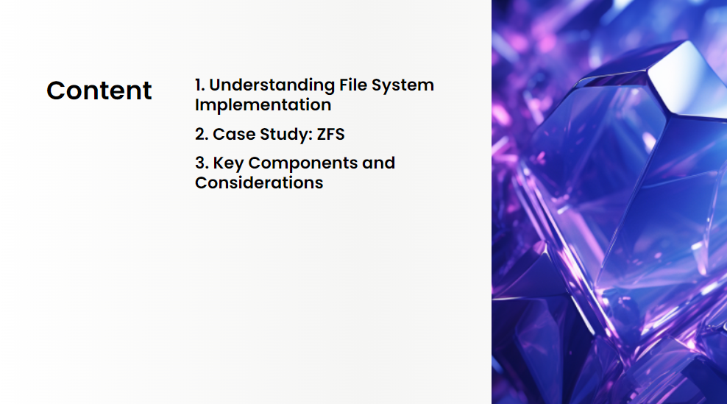

Slide 3


Slide 4
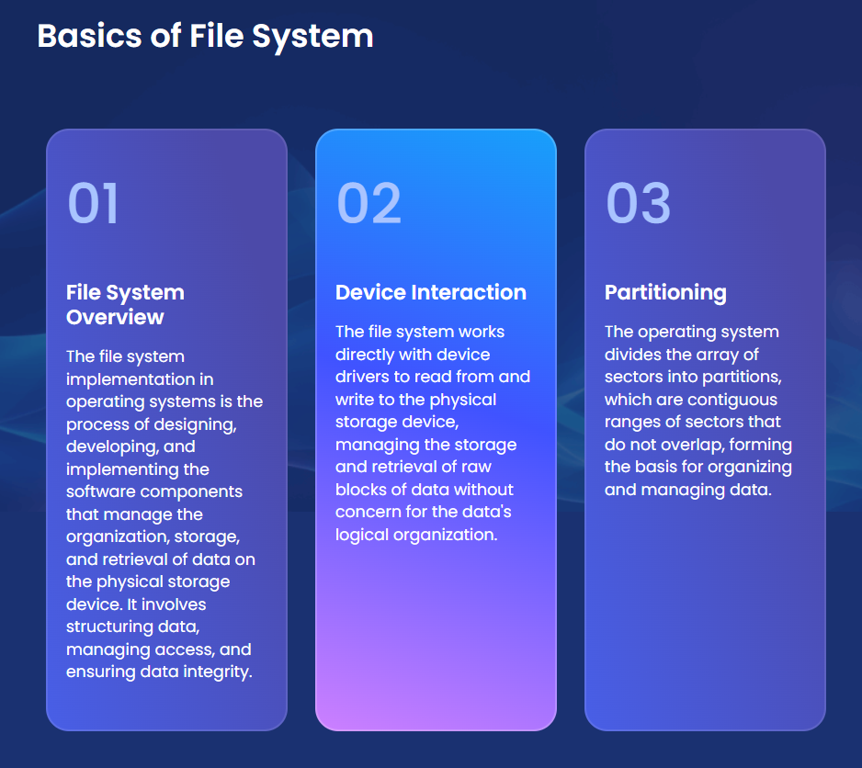

Slide 5
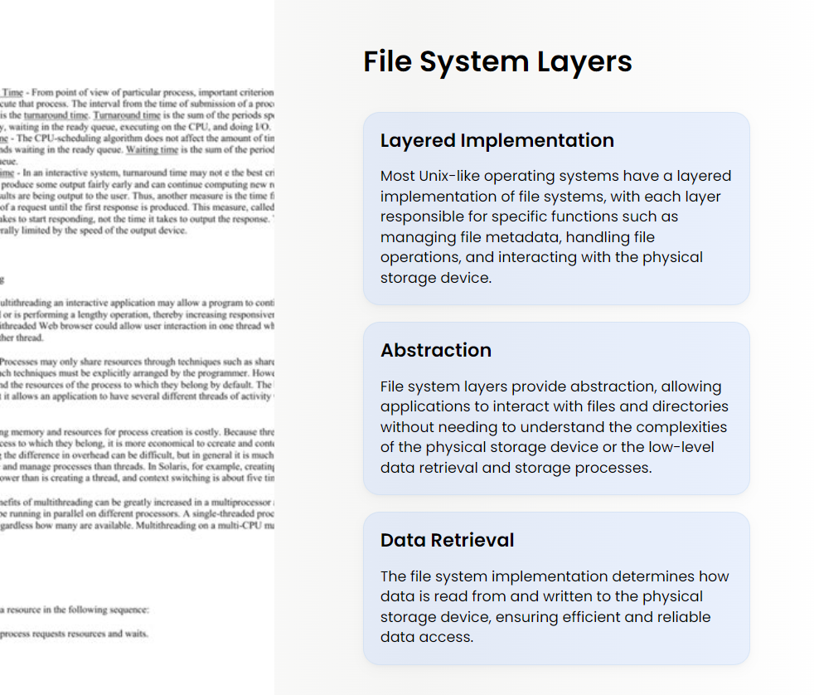

Slide 6


Slide 7
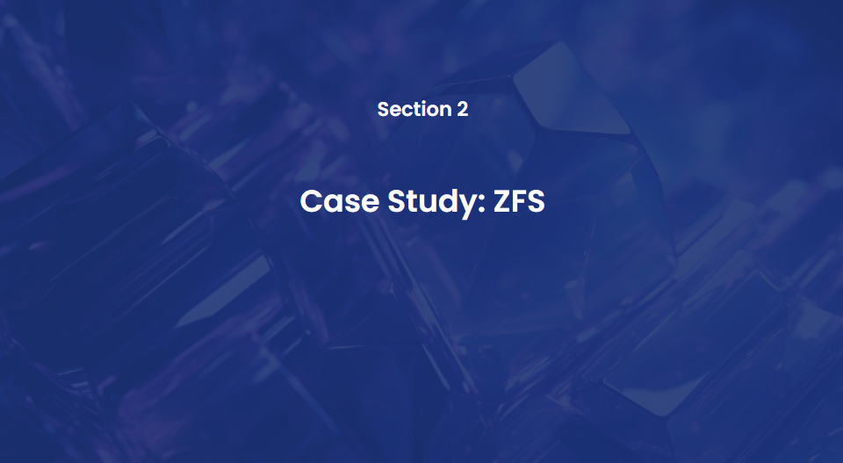

Slide 8
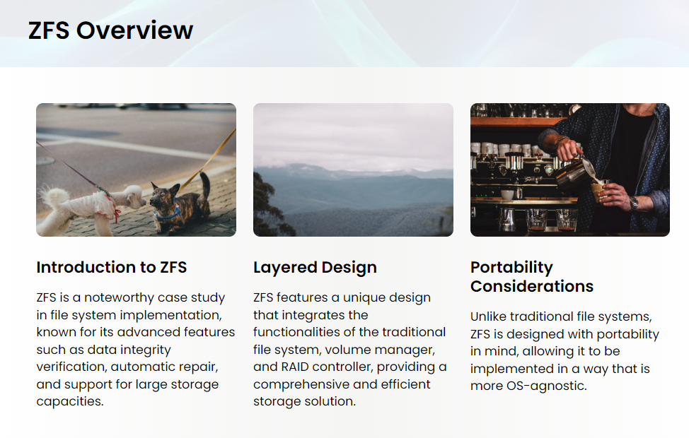

Slide 9
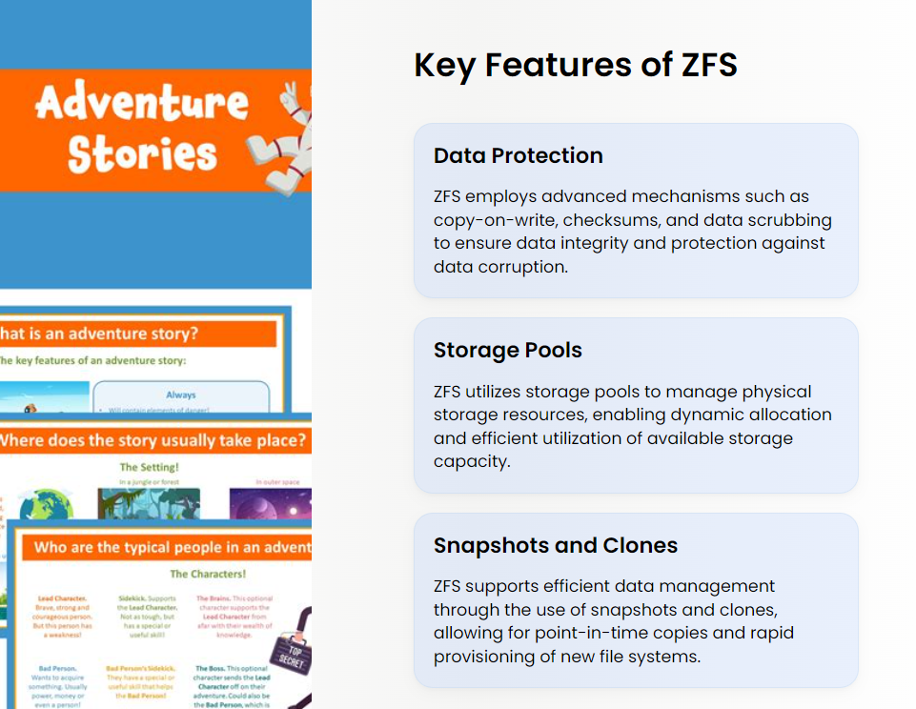

Slide 10
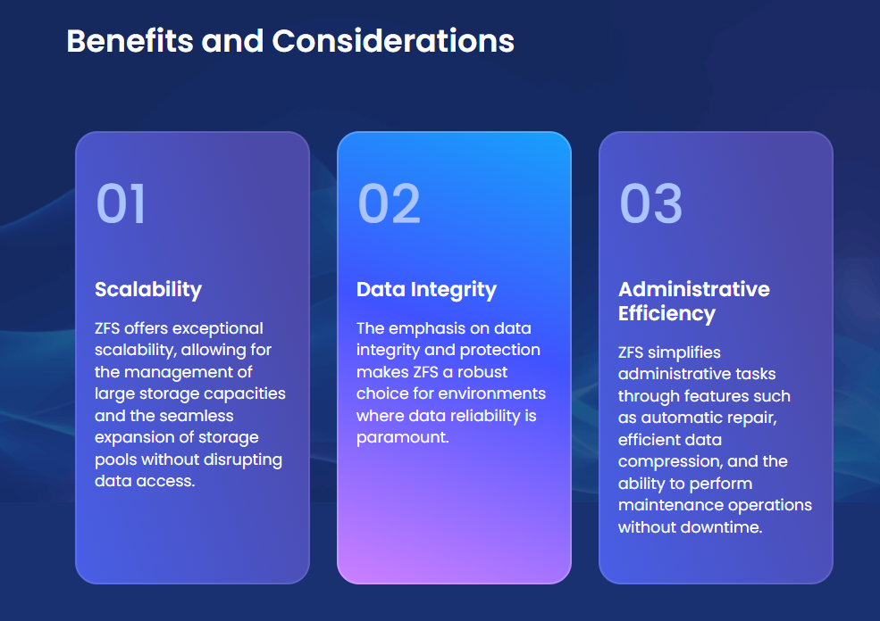

Slide 11
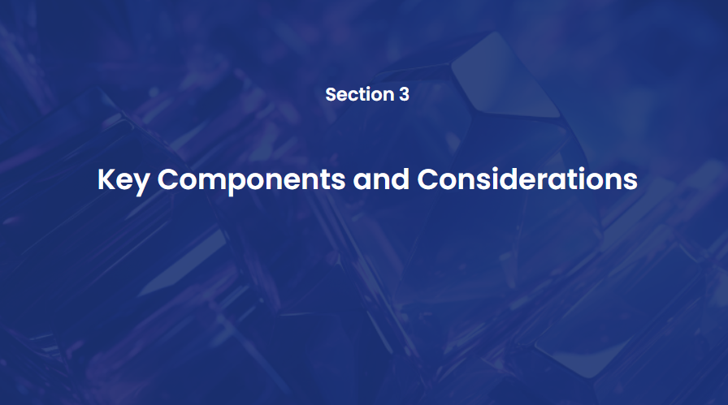

Slide 12


Slide 13
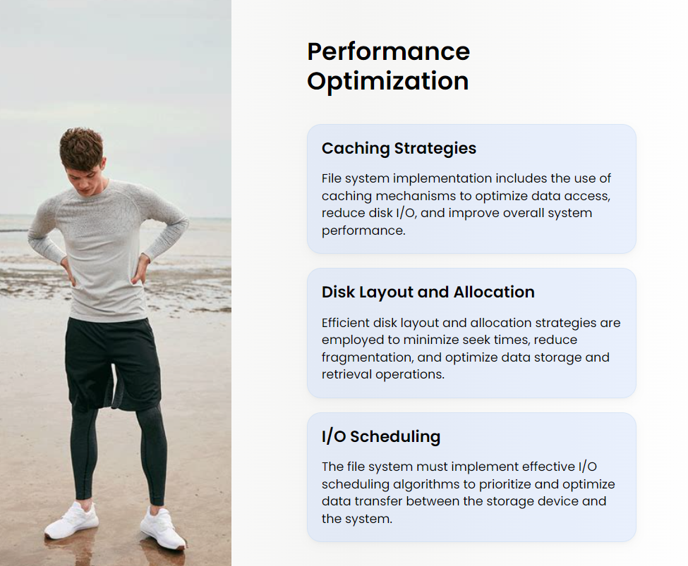

Slide 14


Slide 15


